Slide 1
SHORTEST COMMON
SUPERSEQUENCE
Tanvi Chalisgaonkar
Roll no. : 187943
Reg no. : MC18106
M.C.A {II year (IV sem)}
AAD Minor II

Slide 2
Definition:-
The SHORTEST COMMON SUPERSEQUENCE of two sequences X and Y is the shortest sequence which has X and Y as subsequences.
Problem Statement:-
Given two strings str1, str2 . Write an algorithm to find shortest string which contains
both str1,str2 as substrings.
Input: Two sequences X and Y.
Output: Length of Shortest common super sequence of X and Y.
Example: Let X=“abc” and Y=“abb” . Then shortest common subsequence for X and Y
are “abbc” and “abcb”, which have length =4.

Slide 3
Recursive Approach:-
Let X=“abc” and Y=“abb” be two string.
m = length of string X.
n = length of string Y.
Base Case: If any of string is of length 0 then length of shortest common super sequence is length of the another string.
if(m=0) then return n;
if(n=0) then return m;
Recursive Case: If i th character is same then add 1 to solution and make a recursive call for m-1 and n-1.
else add 1 to the minimum value from recursive call for (m-1,n) and (m,n-1).

Slide 4
Pseudo Code: -
Let X[0..m - 1] and Y[0..n - 1] be two strings and m and n be respective lengths.
if (m == 0) return n;
if (n == 0) return m;
// If last characters are same, then add 1 to result and
// recur for X[] Y[]
if (X[m - 1] == Y[n - 1]) return 1 + SCS(X, Y, m - 1, n - 1);
// Else find shortest of following two
// a) Remove last character from X and recur
// b) Remove last character from Y and recur
else return 1 + min( SCS(X, Y, m - 1, n), SCS(X, Y, m, n - 1) );

Slide 5
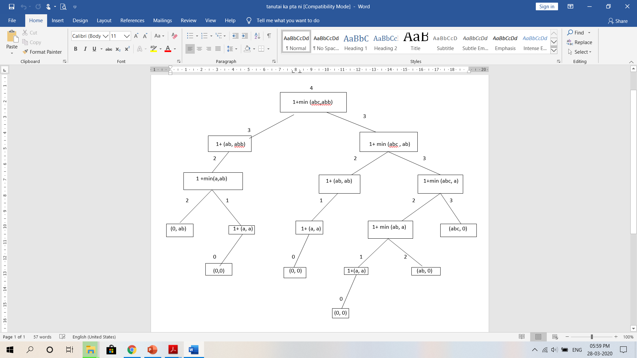
SUB - STRUCTURE

Slide 6
From the above structure we can easily see the overlapping sub problems such as:
(“a” , “a”)
(“ab” , “a”) ………… etc.
So Recurrence relation is:
F( X, Y, m, n) = 1 + min( F(X,Y,m-1,n) ,F(X,Y,m,n-1) ) if m>0 and n>0
0 else where
Time Complexity :
T(n) = O(2^{min(m, n)}).

Slide 7
DYNAMIC PROGRAMMING APPROACH
Since, recursive approach gives exponential complexity and have optimal substructure
of problem ,So we can apply dp to memoize the result.
Let dp[m][n] be an 2-D array:
then memoization will take place as follows:
 | 0 | a | b | c
0 | 0 | 1 | 2 | 3
a | 1 | 1 | 2 | 3
b | 2 | 2 | 2 | 3
b | 3 | 3 | 3 | 4

Slide 8
TOP – DOWN APPROACH
//Initialize dp array with -1
for(i=1 to m)
for(j=1 to n)
dp[i][j] =-1;
int SCS(string X, string Y, int m, int n, int dp[m][n])
{
if(m==0) return dp[m][0] = m; //Base Case
if(n==0) return dp[0][n] = n;
if(dp[m][n] != -1) return dp[m][n];
if(X[m] == Y[n]) return dp[m][n] = 1+ dp[m-1][n-1]; //Recursive Case.
else
return dp[m][n] = 1 + min( SCS(X, Y, m-1, n), SCS(X, Y, m, n - 1) );
}

Slide 9
BOTTOM - UP APPROACH
int superSeq(char* X, char* Y, int m, int n)
{
int dp[m + 1][n + 1];
// Fill table in bottom up manner
for (int i = 0; i <= m; i++)
{
for (int j = 0; j <= n; j++)
{
// Below steps follow above recurrence
if (i==0)
dp[i][j] = j;
else if (j==0)
dp[i][j] = i;
else if (X[i - 1] == Y[j - 1])
dp[i][j] = 1 + dp[i - 1][j - 1];
else
dp[i][j] = 1 + min(dp[i - 1][j],
dp[i][j - 1]);
}
}
return dp[m][n];
}

Slide 10
TIME COMPLEXITY FOR DYNAMIC PROGRAMMING:
Time Complexity for both top-down and bottom-up case is comes out to be O(mn).
T(n) = O(mn)

Slide 11
ANOTHER APPROACH USING LONGEST COMMON SUBSEQUENCE:
Shortest common super sequence can also be found with the help of longest common subsequence. By using formula given below:
Length of the shortest super sequence = (Sum of lengths of given two strings) –
(Length of LCS of two given strings)
Example for above idea is:
Let us consider another example, str1 = “AGGTAB” and str2 = “GXTXAYB”.
LCS of str1 and str2 is “GTAB”.
And Shortest Common Super sequence is “AGXGTXAYB”.
Now, length of str1 = 6 , length of str2 = 7 and length of lcs = 4.
Then length of super sequence = 6 + 7 - 4 = 9.

Slide 12
IMPLEMENTATION OF ABOVE APPROACH IS AS FOLLOWS:
Consider that lcs can be calculated by any of the known method.
int shortestSuperSequence(char *X, char *Y)
{
int m = strlen(X), n = strlen(Y);
// find lcs
int l = lcs(X, Y, m, n);
// Result is sum of input string
// lengths - length of lcs
return (m + n - l);
}

Slide 13
PRINTING THE SOLUTION FOR SHORTEST COMMON SUPERSEQUENCE:
int index = dp[m][n];
// Create a string of size index+1 to store the result
string res(index+1, '\0');
// Start from the right-most-bottom-most corner and
// one by one store characters in res[]
int i = m, j = n;
while (i > 0 && j > 0)
{
// If current character in a[] and b are same,
// then current character is part of LCS
if (a[i-1] == b[j-1])
{
// Put current character in result
res[index-1] = a[i-1];
// reduce values of i, j and indexs
i--; j--; index--;
}
P.T.O

Slide 14
// If not same, then find the larger of two and
// go in the direction of larger value
else if (dp[i-1][j] < dp[i][j-1])
{ res[index-1] = a[i-1]; i--; index--; }
else
{ res[index-1] = b[j-1]; j--; index--; }
}
// Copy remaining characters of string 'a'
while (i > 0)
{
res[index-1] = a[i-1]; i--; index--;
}
// Copy remaining characters of string 'b'
while (j > 0)
{
res[index-1] = b[j-1]; j--; index--;
}
// Print the result
cout << res;

Slide 15
THANK YOU

